Slide 1

Exam Tips and Tricks
Exam Information
Technology Changes
Question Types
Exam Strategies
Additional Resources

Slide 2










Mike Corkery Microsoft Certified Trainer (MCT) Microsoft MVP (2012 – 2015) Certification Addict

Slide 3
Exam Information
Know what is in scope for the exam

Slide 4
RoadMap – Azure Certifications
MCSA – Cloud Platform, pass two of the following exams
70-473 Designing and Implementing Cloud Data Platform Solutions
70-475 Designing and Implementing Big Data Analytics Solutions
70-532 Developing Microsoft Azure Solutions
70-533 Implementing Microsoft Azure Infrastructure Solutions
70-534 Architecting Microsoft Azure Solutions
MCSE – Cloud Platform and Infrastructure
Requires MCSA – Cloud Platform
Pass one additional exam including: 70-246, 70-247, 70-413, 70-414, 70-473, 70-475, 70-532, 70-533, 70-534, 70-744

Slide 5
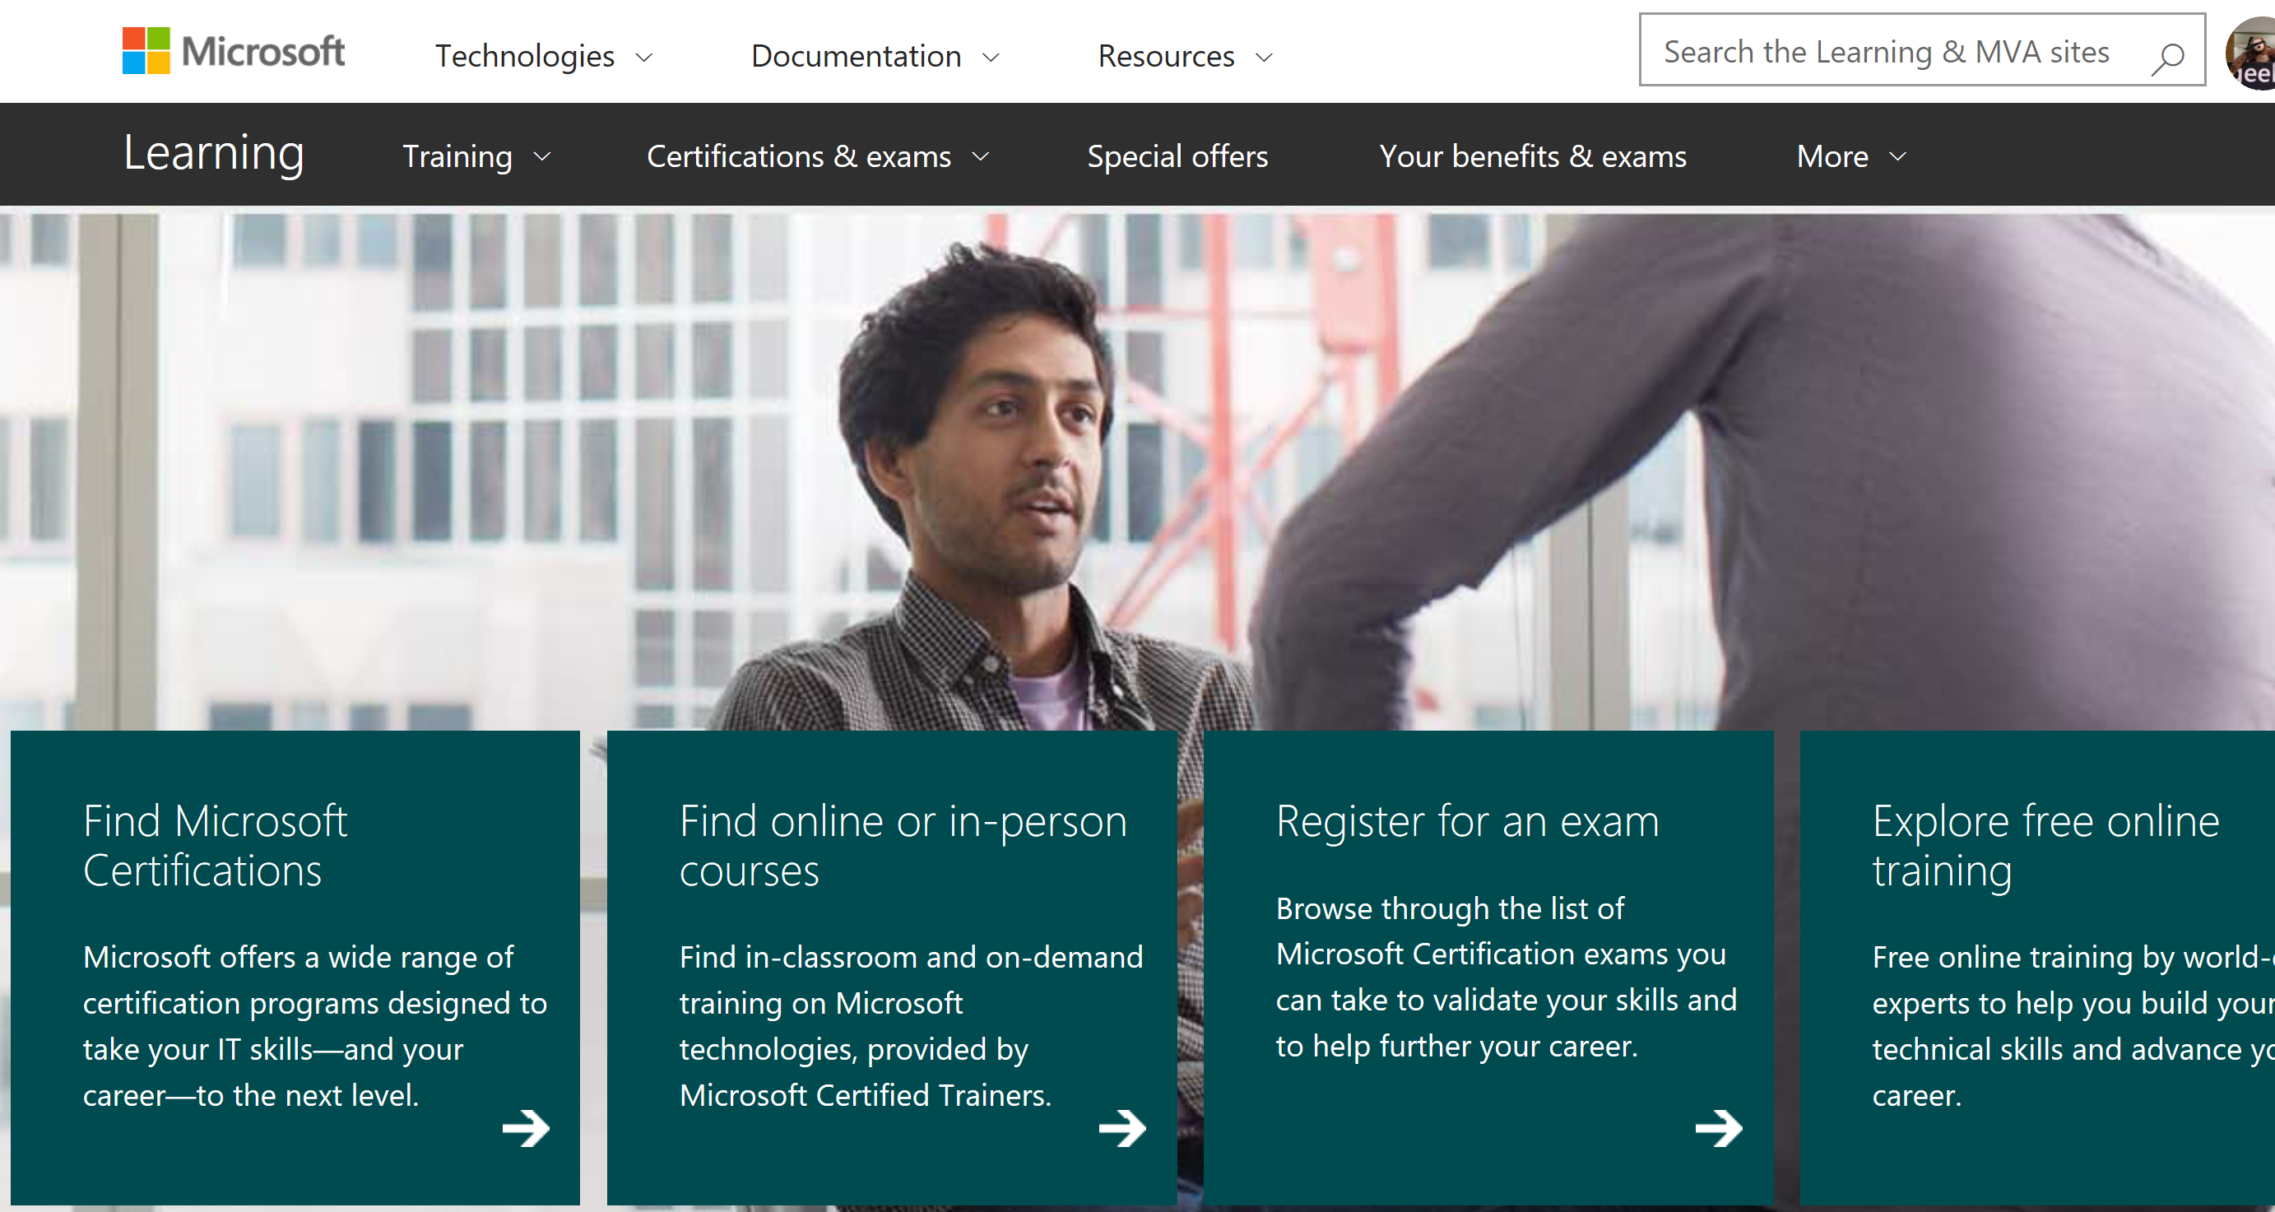
Consult the Official Exam Page for Your Exam
The exam page is the single point of truth for exam information.

Slide 6
The Times the are a Changing
Dealing with the pace of changes in technology

Slide 7
Azure Exam Refreshes
Exams are refreshed regularly
The MS Learning exam page announces significant changes before changes go live
You can now re-earn specific certifications yearly
“Since the last exam update, Microsoft Azure has had significant technology changes, and we are updating the exam objectives to include them. As of November 22, 2016, this exam reflects these changes.”

Slide 8
Question Types
How Exam Authors Ask Questions

Slide 9
Multiple Choice and Variants
1, 2, or 3 correct answers
Dynamic Option Multiple Choice is relatively new

Slide 10
Case Studies
Testlet with background, requirements, and other resources, may include code, markup, PowerShell, etc.
Includes 1 or more related questions
Once you complete a case study section, you cannot return to it
Why? Real world situations
Strategy: Read all of the questions first, then read through the case study document.

Slide 11
Standard Multiple Choice Item
You are architecting a solution for a client.
You need to ensure that the key stakeholder buys in to the design.
What should you bring to the meeting?
Hammers
Junk Food
Money
Penny Candy

Slide 12
Dynamic Option Multiple Choice Item
You are architecting a solution for a client.
You need to ensure that the key stakeholder buys in to the design.
You bring penny candy to the meeting with the stakeholder.
Does the solution meet the goal?
Yes
No

Slide 13
Other Item Types
Select answer options and place them in the correct order
Drag answer options into a table, diagram, code, markup, or PowerShell
Analyze code, markup, ARM templates, PowerShell scripts to test your understanding

Slide 14
Set-Based Items
Groups of questions may be presented as sets.
Sets may share elements (scenario and/or answer choices).
Ability to return to sets or questions in a set may be restricted.

Slide 15
Get Ready and Take the Exam
Know what is in scope for the exam

Slide 16
Get Ready
Practice, practice, practice
Run virtual labs
Read up on what is new
Do not use brain dump sites

Slide 17
Read the Entire Item
One word or number can make a difference.
Read the boilerplate text and instruction statements.
Exam items are not written with any intent to trick, obfuscate, or deceive.

Slide 18
Consult the Official Exam Page for Your Exam
The exam page is the single point of truth for exam information.

Slide 19
Save Money on Your Exams
The Special offers link lists current promotions and discount.

Slide 20
Leave Comments About Exam Questions
Deprecated technology
Question is confusing or unclear
Branding has changed
You really like a question
Typographical errors
Functionality issues

Slide 21
Additional Resources
Microsoft Learning home page
Microsoft Born to Learn site
Microsoft Technet Learning Resources
Microsoft Virtual Academy
Edx.org
MeasureUp

Slide 22
Questions?
Michael Corkery
mjcorkery@CSSIofMA.com

Slide 23

© 2015 Microsoft Corporation. All rights reserved. Microsoft, Windows, and other product names are or may be registered trademarks and/or trademarks in the U.S. and/or other countries.
The information herein is for informational purposes only and represents the current view of Microsoft Corporation as of the date of this presentation. Because Microsoft must respond to changing market conditions, it should not be interpreted to be a commitment on the part of Microsoft, and Microsoft cannot guarantee the accuracy of any information provided after the date of this presentation. MICROSOFT MAKES NO WARRANTIES, EXPRESS, IMPLIED OR STATUTORY, AS TO THE INFORMATION IN THIS PRESENTATION.

